Slide 1
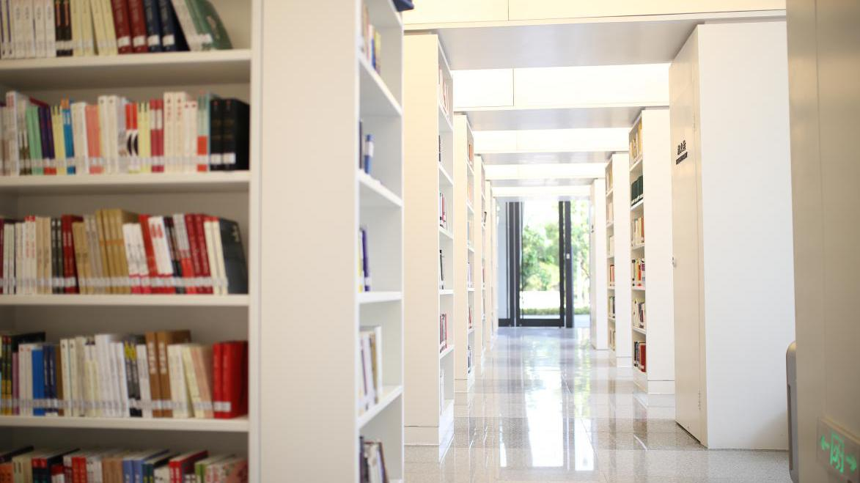
GREEN EFFORTS
OF PINGSHAN LIBRARY

Slide 2
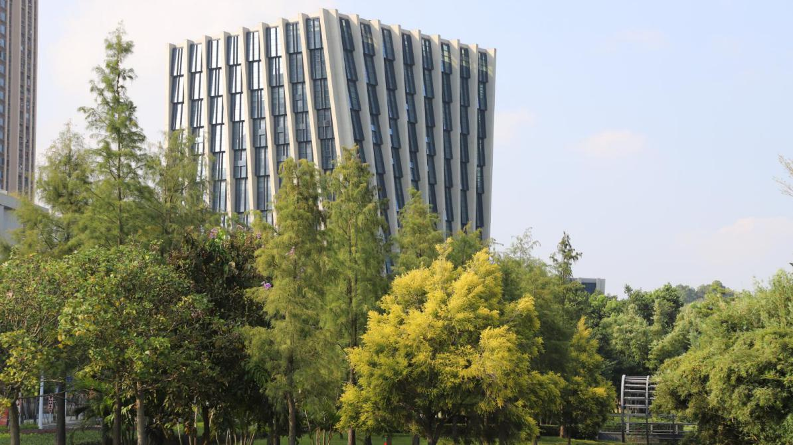
PREFACE
Pingshan Library is located in Pingshan District, Shenzhen, China.
Since 2002, China has vigorously implemented the sustainable development strategy. As one of the first-tier cities of China, Shenzhen is committed to becoming an eco-friendly city where people and nature harmoniously coexist. As an important public education platform of northeast Shenzhen, Pingshan Library has made a series of green efforts to promote the concept of sustainable development and environmental protection.
This article will illustrate the green efforts of Pingshan Library from four aspects: green environment; green design and operation; green activities; Green Plan.

Slide 3
Green Environment
READING MONTH
IN 2019 EVENT PIANNING
Green Design and Operation
CONTENTS
Green Activities
Green Plan

Slide 4
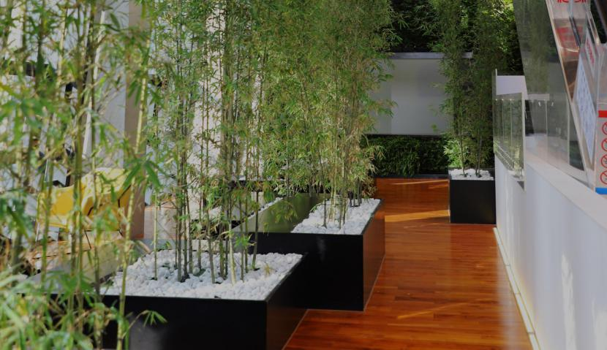
01
01
Green Environment

Slide 5
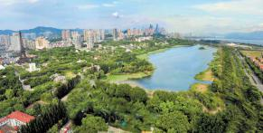
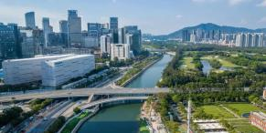
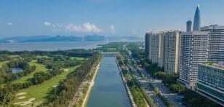
Green Environment of Shenzhen
Shenzhen puts great efforts into forest city construction and ecological restoration. It has won a series of green honors such as "National Forest City", “National Afforestation Model City","International Garden City" and "China Habitat Environment Prize”.
“Let the forest into the city, making the city to embrace the forest. ” The life vision advocated by "National Forest City” can be seen most realistically in Shenzhen. At present, the forest coverage of Shenzhen is at a rate of 40.68%. Citizens can reach the community park within 500 meters, while reaching the city comprehensive park within 2 kilometers and the suburban forest park within 5 kilometers. Moreover, Shenzhen has 4 nature reserves with an area of ​​22,000 hectares.

Slide 6
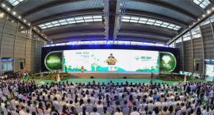
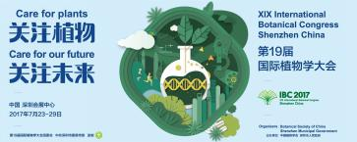
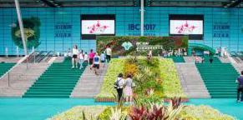
Green Environment of Shenzhen
The 19th International Botanical Congress was held in Shenzhen. The theme of the congress is “Care for plant，care for future.” The congress is divided into 6 parts, covering basic plant science, industrial applications, ecological security, environmental protection, and the common challenges faced by mankind.
The International Botanical Congress is a plant science conference authorized by International Association of Botanical and Mycological Societies. It covers all branches of plant science，and it is the highest level meeting in the field of botany.
2019年3月20日

Slide 7
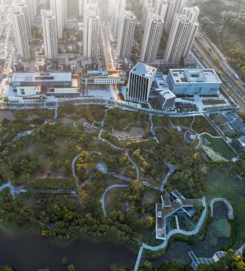
Green Environment of Pingshan
Pingshan District is the youngest administrative district of Shenzhen. It strives to realize the coordination of economic development and environmental protection，and has developed three major environmental friendly industry clusters including Biology Industry Cluster, New Energy Vehicles Industry Cluster, New-Generation Information Technology And Intelligent Manufacturing Industry Cluster.
With the forest coverage rate of 45%，Pingshan District had been awarded as "National Ecological Civilization Construction Demonstration Zone”. Shenzhen Natural Science Museum，which is one of the "Top Ten New Cultural Facilities" in Shenzhen, settled in Pingshan in 2019. “Nature” has become one of the keywords of Pingshan's future construction and development.
2019年3月20日

Slide 8
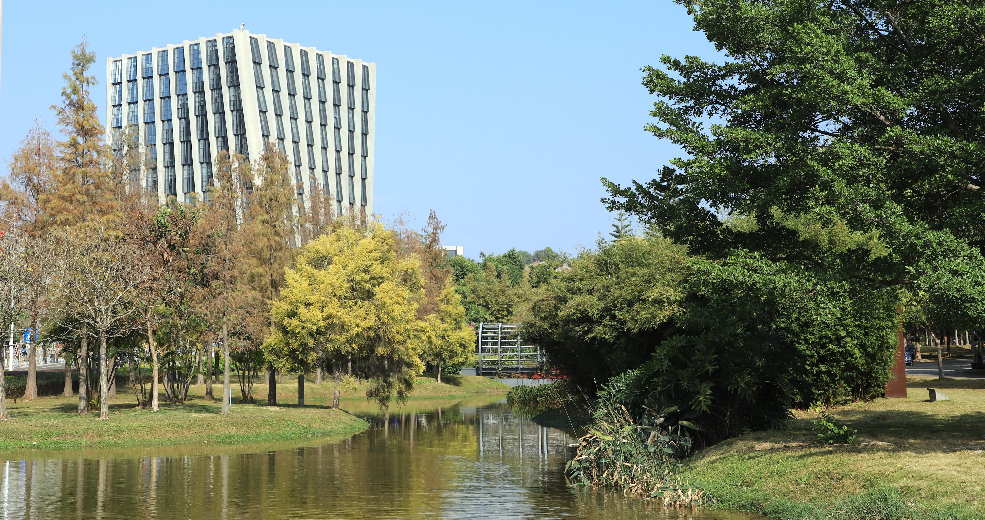
Green environment of Pingshan Library
Pingshan Library is located at Pingshan Culture Centre, which is connected to Pingshan Central Park.
As an important public education platform in northeast Shenzhen, Pingshan Library has always integrated the green concept into the library's designs, operations, activities and development plans.

Slide 9
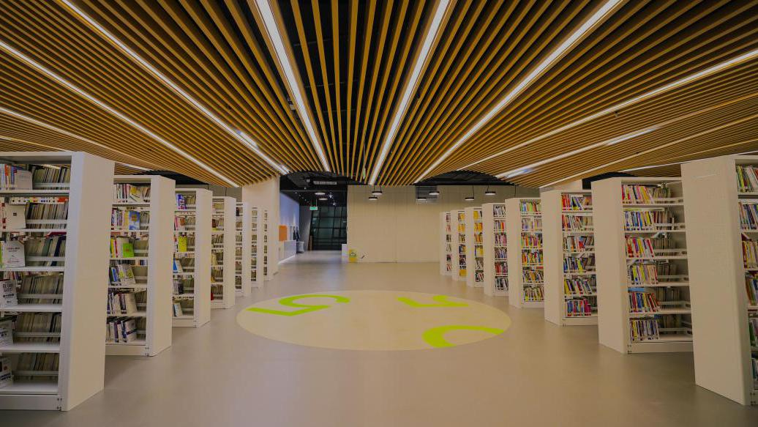
02
Green Design
and Operation

Slide 10
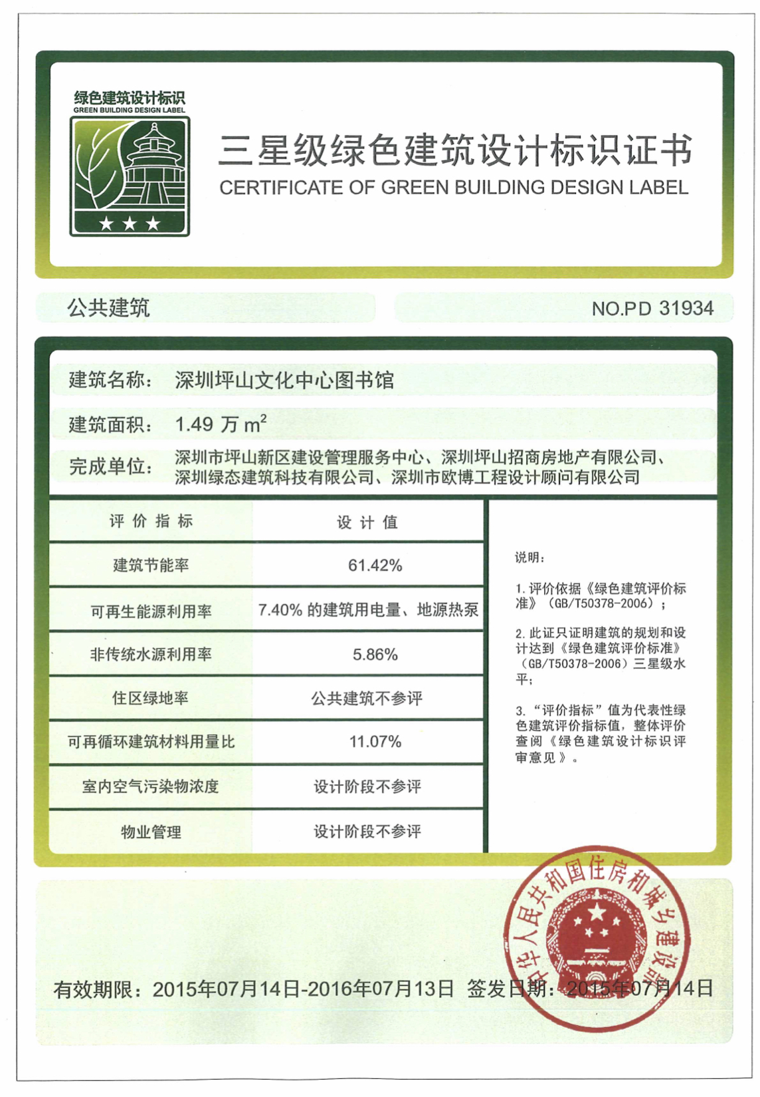
China’s Three-star
Green Building Design
The building is qualified as China’s Three-star Green Building Design.
Three-star Green Building Design is the highest certification in China’s green building evaluation system.
“Green Building Evaluation Standards" is issued by the Ministry of Construction and jointly edited by the China Academy of Building Sciences and the Shanghai Academy of Building Sciences.

Slide 11
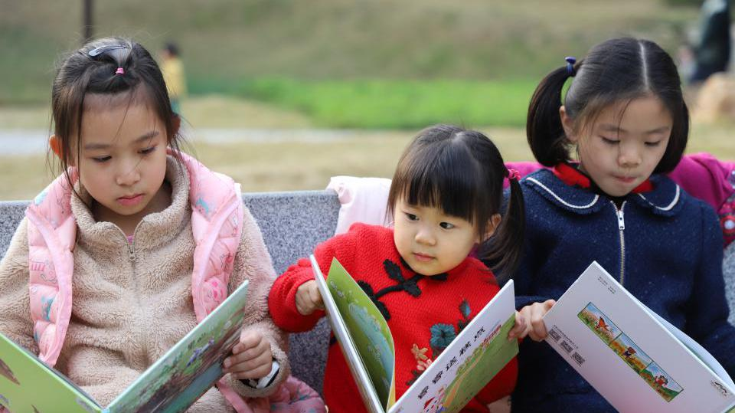
Design That Connect Society to Nature
The design of Pingshan Library highlights the concept of green community. To raise readers’ interest of reading in nature, the designer set up an exit on the east side of the library where is connected to Pingshan Central Park. In order to enhance readers’ willingness to walk to the park in summer, the designer incorporated the subtropical shading requirements into the design plan, using greening shrub and building components to achieve shading effect.
目录/00

Slide 12
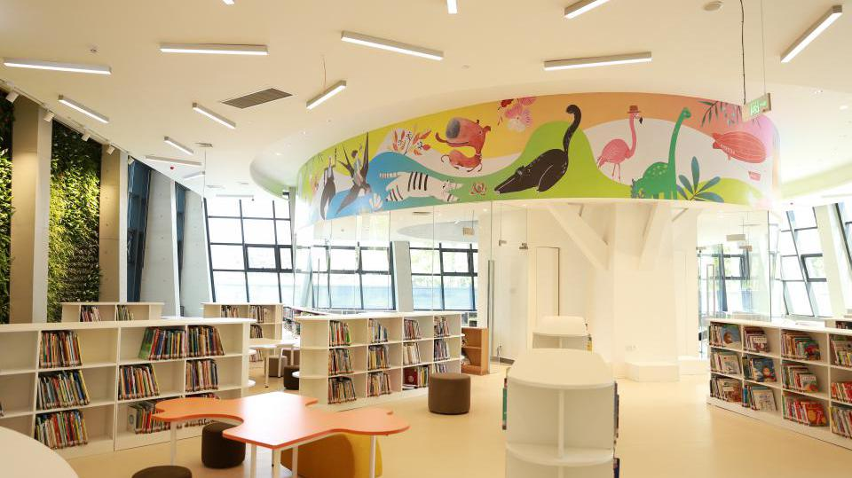
The Application of Green Building Materials
In order to minimize environmental load and create a healthy environment, we select green building materials such as energy-saving low-e glass, aerated concrete hollow blocks, ready-mixed mortar, to substitute chlorine-based plastic products，PVC and PCB. In addition，we have already carried out life cycle assessment and environmental impact assessment for the selected construction materials.
目录/00

Slide 13
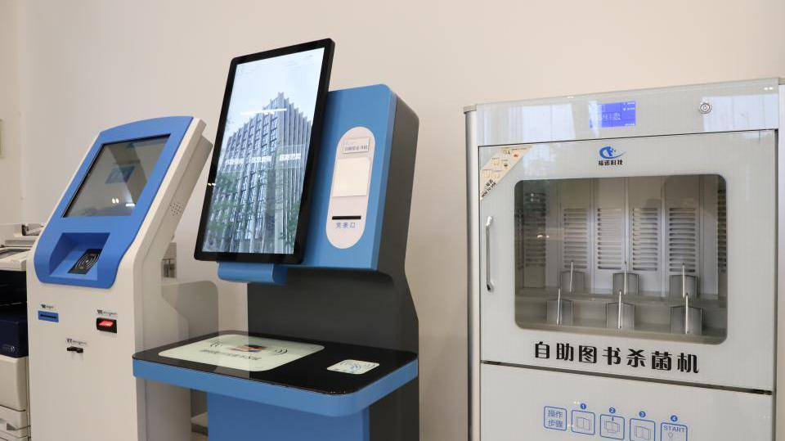
The Comprehensive Utilization of Resources
In order to maximize the comprehensive utilization of resources and minimize energy consumption，we share equipment with surrounding venues such as Pingshan Art Museum，Pingshan Central Book City and Pingshan Grand Theater.
目录/00

Slide 14
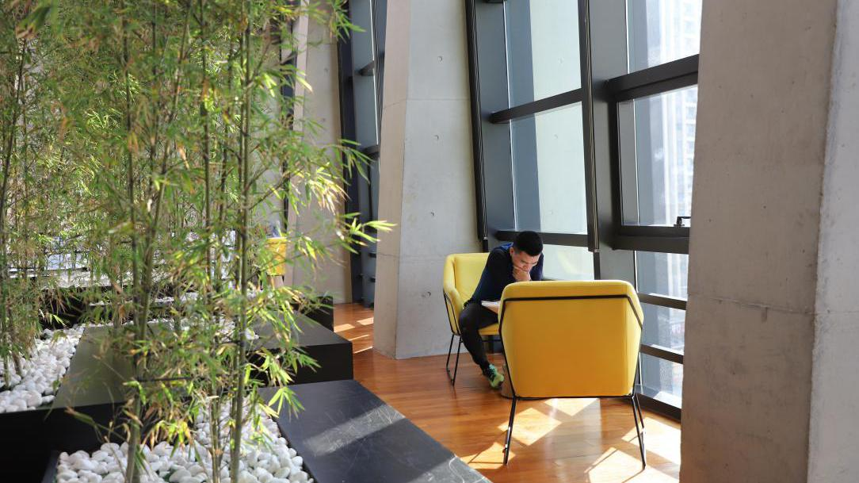
The Application of Green Lighting Design
The application of green lighting design is mainly reflected in three aspects.
Glass walls are installed on all sides of the building to ensure sufficient indoor natural light.
目录/00

Slide 15
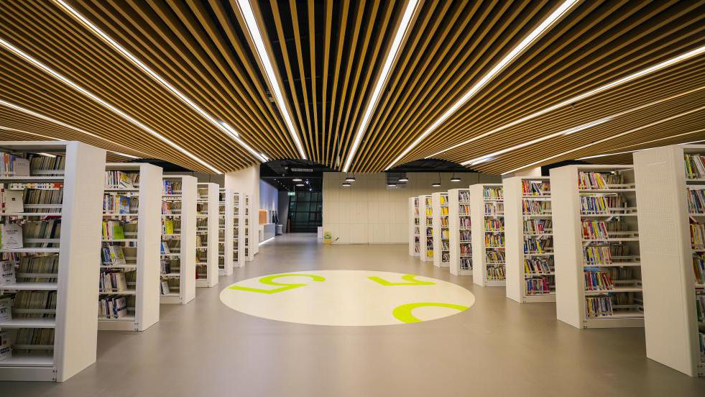
The Application of Green Lighting Design
LED lights have been widely used as artificial lighting sources, reducing energy consumption by 70% compare with traditional lighting, and 50% compare with general energy-saving lamp.
目录/00

Slide 16
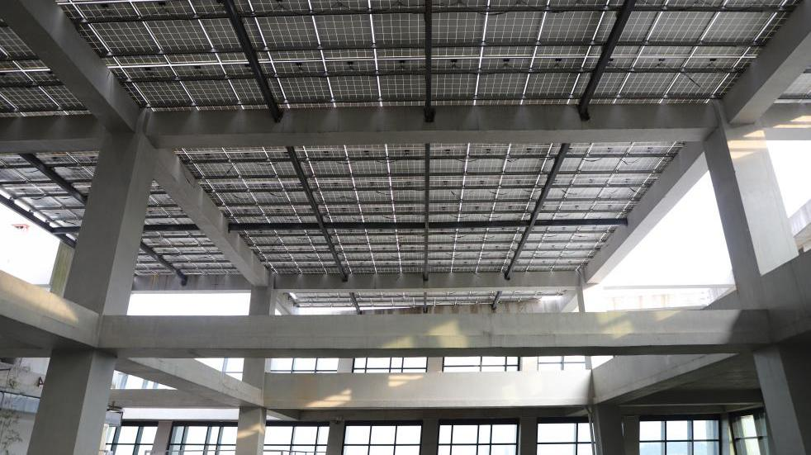
The Application of
Green Lighting Design
By installing solar panel roof, the solar energy is converted into electricity for the library's daily lighting, which meets the library's daily electricity demand of 10%-15%.
目录/00

Slide 17
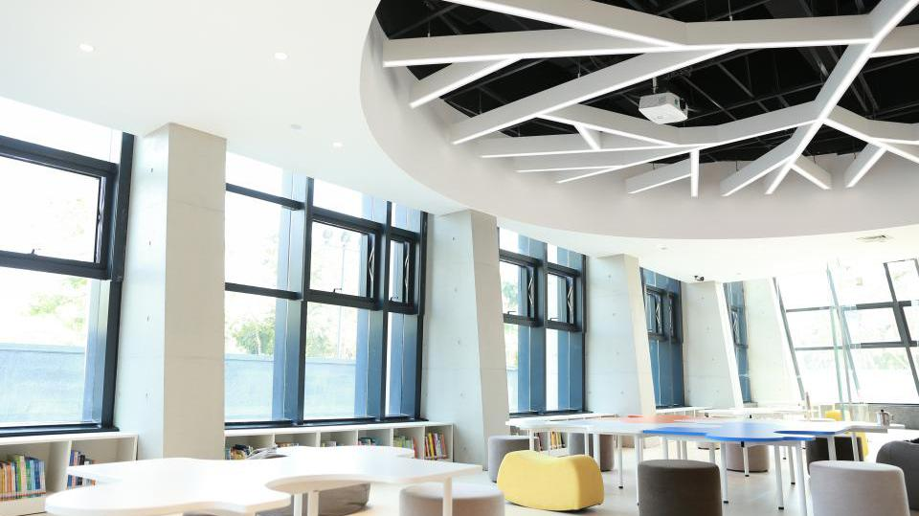
The Application of
Natural Ventilation Technology
Natural ventilation technology was fully utilized to reduce the energy consumption of air conditioning.
Relying on its excellent natural ventilation, Pingshan Library maintains comfortable indoor conditions and healthy living environment especially in spring and autumn.
目录/00

Slide 18
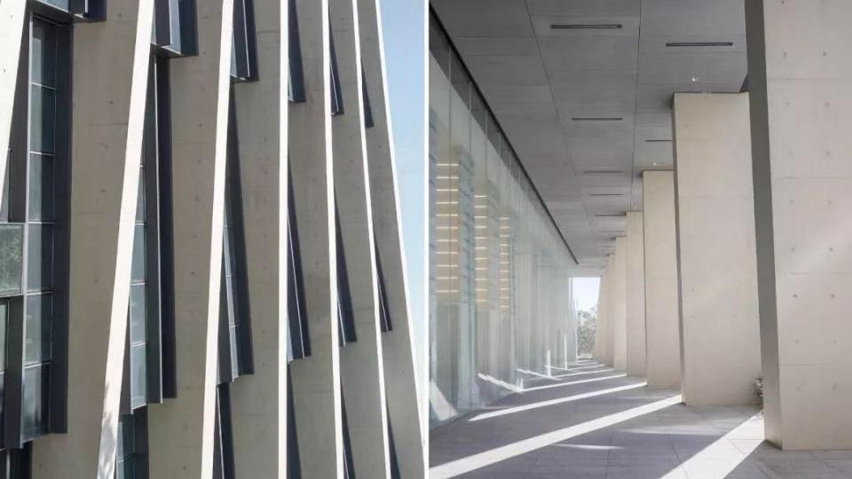
The Application of
Energy-saving Technology
in Building External Envelope Structure Design
The designer applied advanced energy-saving technology such as external wall insulation technology and external shading technology to reduce heat transfer coefficient and equipped the building with excellent thermal insulation performance, which can help to conserve the energy.
目录/00

Slide 19
The Design
of Green Spaces
In order to create green reading spaces for readers, we have designed vertical sky gardens and bamboo spaces. Aside from ecological aesthetic education function, these vertical sky gardens and bamboo spaces could help to regulate indoor temperatures, keeping it warm in winter and cool in summer.

Slide 20
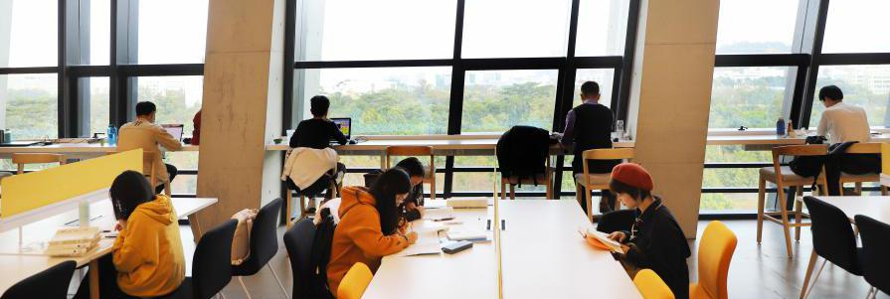
The Design of Green Spaces
There are dozens of window seats on each floor, allowing readers to breathe fresh air and enjoy the green view of Pingshan Central Park outside the window.

Slide 21
The Rainwater Recycling System And Automated Water-saving Sanitary Ware
The rainwater recycling system is applied to recycle rainwater from the roof for flushing toilets and watering green spaces.
In addition，Pingshan Library adopts automatic water-saving sanitary ware, drip irrigation and sprinkler technology to effectively save water.

Slide 22
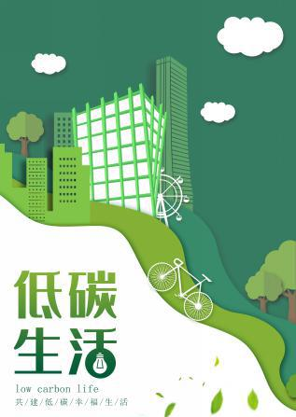
Green operations
Reduce paper consumption: Pingshan Library provides double-sided printing and scanning services for Librarians and readers to reduce paper consumption.
Set the power saving program: the computer will enter into the automatic hibernation state if there is no operation for more than 15 minutes.
Reduce the use of disposable supplies：Pingshan Library does not provide disposable cups. Readers are encouraged to bring their own cups.
Optimize the management of building energy systems: improving operating efficiency and reducing energy consumption.

Slide 23
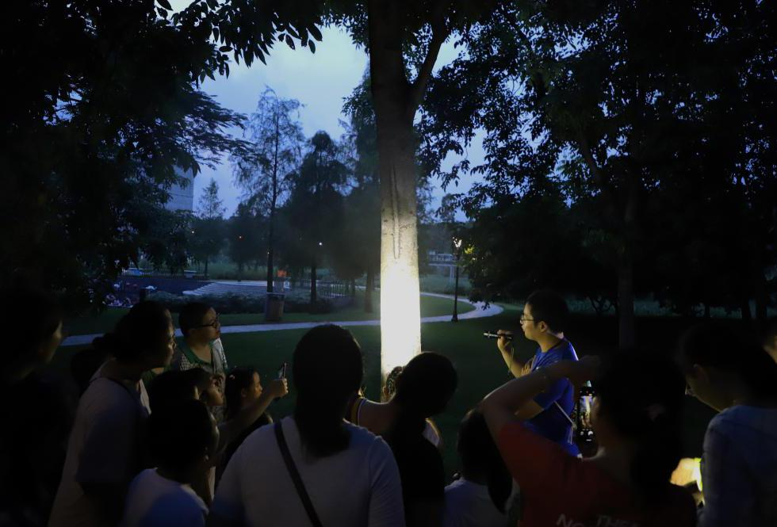
03
Green Activities

Slide 24
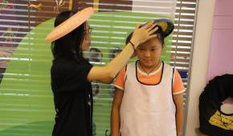
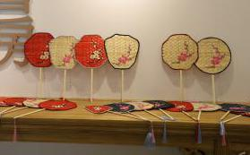
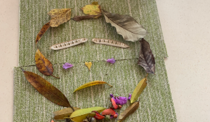
Echo Summer Camp Series
Craftsmanship Carnival and Summer Theme Exhibition
Children look for solar terms signals and experienced the wisdom of time in Chinese solar terms under the guidance of teachers. Children learned to use bamboo, leaves, mats, wheat straw, bamboo cymbals and other natural materials to make summer items such as fans, Hakka hats, and campanula trees. After completing the work, the participants held a theme exhibition in the library, and passed the concept of ecological protection to more readers.

Slide 25
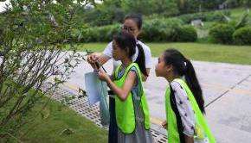
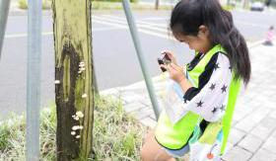
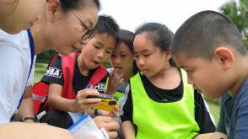
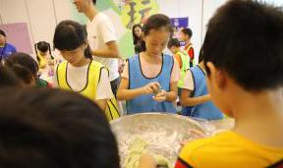
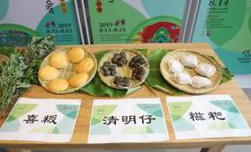
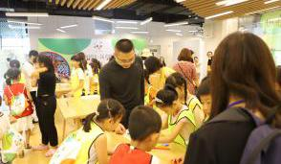
Echo Summer Camp Series
“Wisdom of Summer" "Taste of Time" Salons
Inviting naturalists to share "wisdom of summer" and "taste of time”. Through vivid and interesting activities, children were led to observe seasonal changes, feel the beauty of nature, and raise attention to global warming.

Slide 26
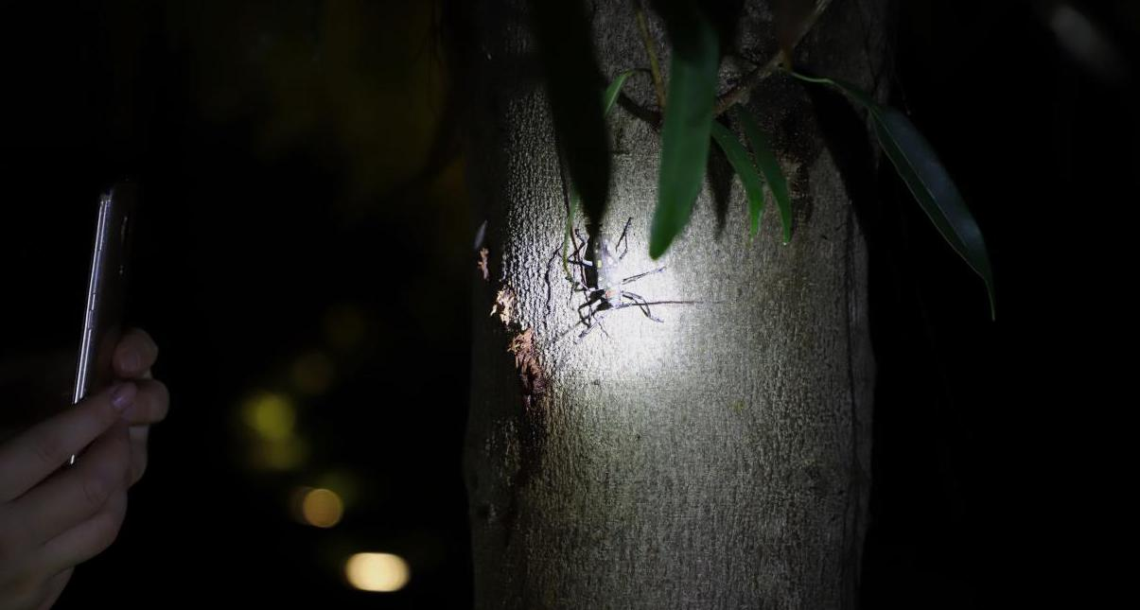
Echo Summer Camp Series
Summer Night View
Nature teachers led children to Pingshan Central Park which is next to Pingshan Library for ecological education. Children followed the teachers to find out insects by sounds, and learned about the ecological habits of these insects.

Slide 27
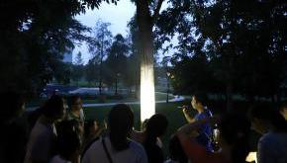
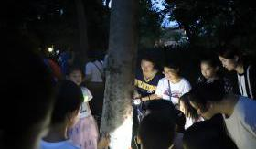
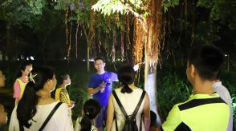
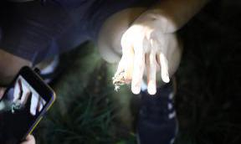
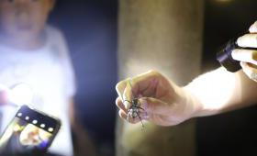
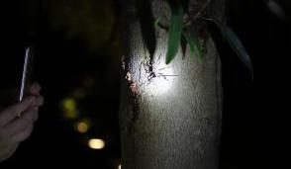
Echo Summer Camp Series
Summer Night View
Through these outdoor nature exploration activities, the seeds of loving nature and protecting environment were planted in the hearts of the children.

Slide 28
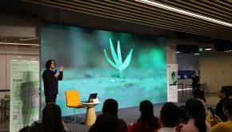
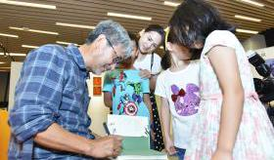
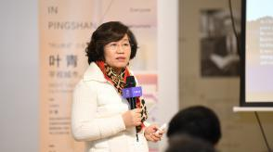
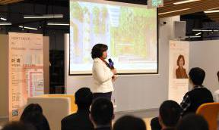
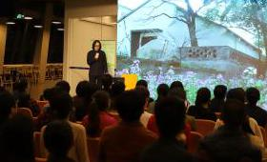
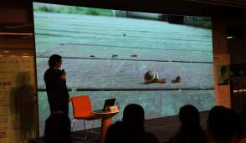
Green Speech Series
“Green Building” " Nature Education"
We have already invited several famous naturalists and architects to share their studies and projects in 2019. We recorded these speeches and posted them on social media to promote their green ideas.

Slide 29
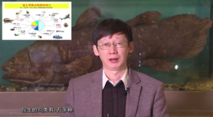
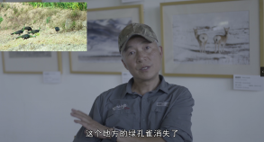
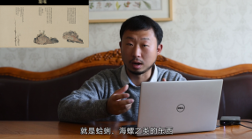
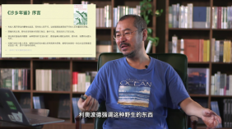
Pingshan Natural History Lecture series
Pingshan Natural History Lecture series are held monthly in 2020 to provide readers an important platform for understanding ecological civilization and enriching natural knowledge. Nature researchers are invited to share “wisdom of summer”with parents and children to arouse readers’ awareness of global warming.

Slide 30
“Pingshan Natural History Book Award”
“Pingshan Natural History Book Award” selection is conducted globally,which selects good books with strict and scientific attitudes, humanistic sentiments, conducive to realistic reform and beneficial to people’s life. The selection also rewards writers with thoughts, visions and literary talents, and organizes co-reading activities on award-winning books to realize “Reading For All, Universal Immersion” with ecological awareness.

Slide 31
Echo Study
“Echo Study" is set up on the sixth floor of Pingshan Library，providing a long-term exhibition of natural handicraft culture for readers by incorporating books, pictures, and various handicraft products.
“Echo Magazine” is committed to rescue and promote traditional Chinese folk culture, which emphasizes the concept of “the unity of mankind and nature”. It has rescued dozens of endangered folk handicrafts, promoting traditional green lifestyle to modern Chinese people.

Slide 32
Han Shaogong Study
”Han Shaogong Study" is set up on the sixth floor of Pingshan Library ， presenting ecological literature works of Han Shaogong and create an immersive reading space for readers.

Slide 33
“Who is Han Shaogong？”
Han Shaogong is one of the representative writers of contemporary Chinese ecological literature. He was awarded the "French Literature And Art Knight Medal” by the French Ministry of Culture in 2002，as well as a lot of other prizes at home and abroad.
His works reflect on the phenomenon of rural variation under the influence of modern civilization，containing profound ecological aesthetics and a sense of life civilization, which have a strong enlightenment to the creation of Chinese ecological literature.

Slide 34
Protection and Promotion of Hakka Ecological Culture
Hakka is an ancient ethic group in China. Hakka people have accumulated unique ecological culture because of their lifestyle. Pingshan Library fully excavates and preserves Hakka culture. There are more than 3,200 volumes of Hakka documents collected here. The carriers are diverse in form and rich in content, which is of great significance to the protection and promotion of Hakka ecological culture.

Slide 35
Green Books Recommendation
The Green Book Shelf is set up to recommend green books to readers. It includes three series: Ecological Literature Series, Natural Exploration Series, Environmental Protection Series.
目录/00

Slide 36
Energy Conservation Week
Pingshan Library made a series of posters to promote green concept，advocating librarians and readers to practice low-carbon lifestyle.

Slide 37
04
Green Plan

Slide 38
The Smart Library
The Smart Library Project of Pingshan Library has started in 2019, and it is expected to be completed in 2022. The establishment of the Smart Library will greatly reduce "carbon footprint”, and provide a green platform for citizens to acquire information and knowledge.

Slide 39
THANKS

