Slide 1

IFLA Elections 2021
Regional Structures

Slide 2
Governance Review: Goal
To give IFLA the structures needed to deliver on the ambition of our Strategy, and become a more inclusive, effective and transparent organisation

Slide 3
Nominations Process: Goal
To get the strongest, most diverse range of candidates ever for positions across IFLA

Slide 4
Our Agenda Today
IFLA’s Regional Council
IFLA’s Regional Division Committees
The Nominations Process
Open Questions

Slide 5
Key Principles for Today
Listen in order to understand
Assume good intentions
Observe time limits
Limit comments to allow others to contribute
Use the chat function
Ask questions if you don’t understand

Slide 6
A Key Innovation
Current regional structures will come to an end
They are being replaced by a new, upgraded Council and Division
These new structures will have a strong focus on advocacy

Slide 7
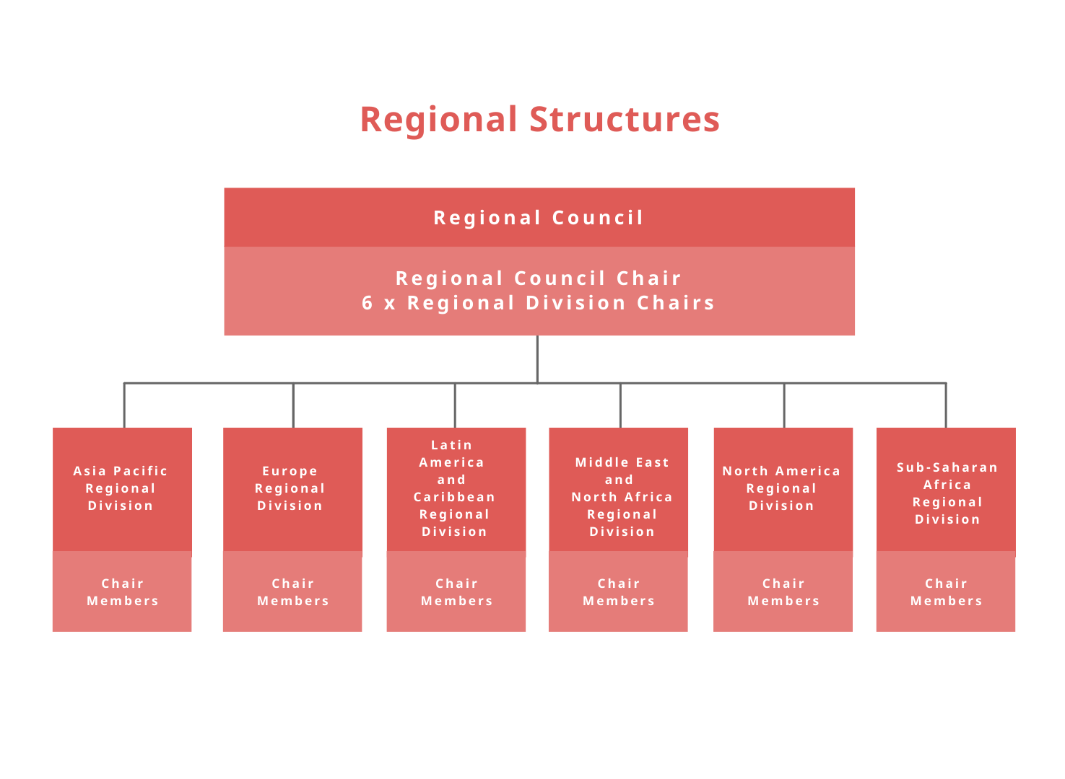
Regional Structures

Slide 8
Regional Council
Role: coordinate the work of the Regional Divisions, especially strengthening advocacy and supporting the visibility, coherence and effectiveness of IFLA's work. It is comprised of the Chair of the Regional Council and the 6 Regional Division Committee Chairs.
Chair: coordinate and support the development of regional division action plans, review activities and raise emerging issues to the Governing Board. Lead efforts to provide input on IFLA advocacy, review success in developing the regional dimension of the IFLA Strategy, as well as work to promote IFLA membership and fundraising in the regions.

Slide 9
Regional Council Chair:
Expected experience and skills
expertise, experience and interest in library policies and advocacy;
expertise, experience and interest in/across the library field, in different world regions;
proven ability to inspire, provide guidance and support, and represent the interests of a diverse range of colleagues;
an understanding of financial management, fundraising and risk-management;
an understanding of strategic planning, implementation and review processes;
proven leadership skills, with experience in communication, representation, and networking;
willingness and ability to devote time and energy to the role;
an ability to act with respect, trust, confidentiality and transparency

Slide 10
Regional Council Chair:
Nomination requirements
Position | Who can Stand? | Who can Nominate? | How many nominations? | Who can vote?
Regional Council Chair | Anyone | Members and Affiliates | 5 | Members and Affiliates

Slide 11
Questions and Answers:
Regional Council

Slide 12
Regional Structures

Slide 13
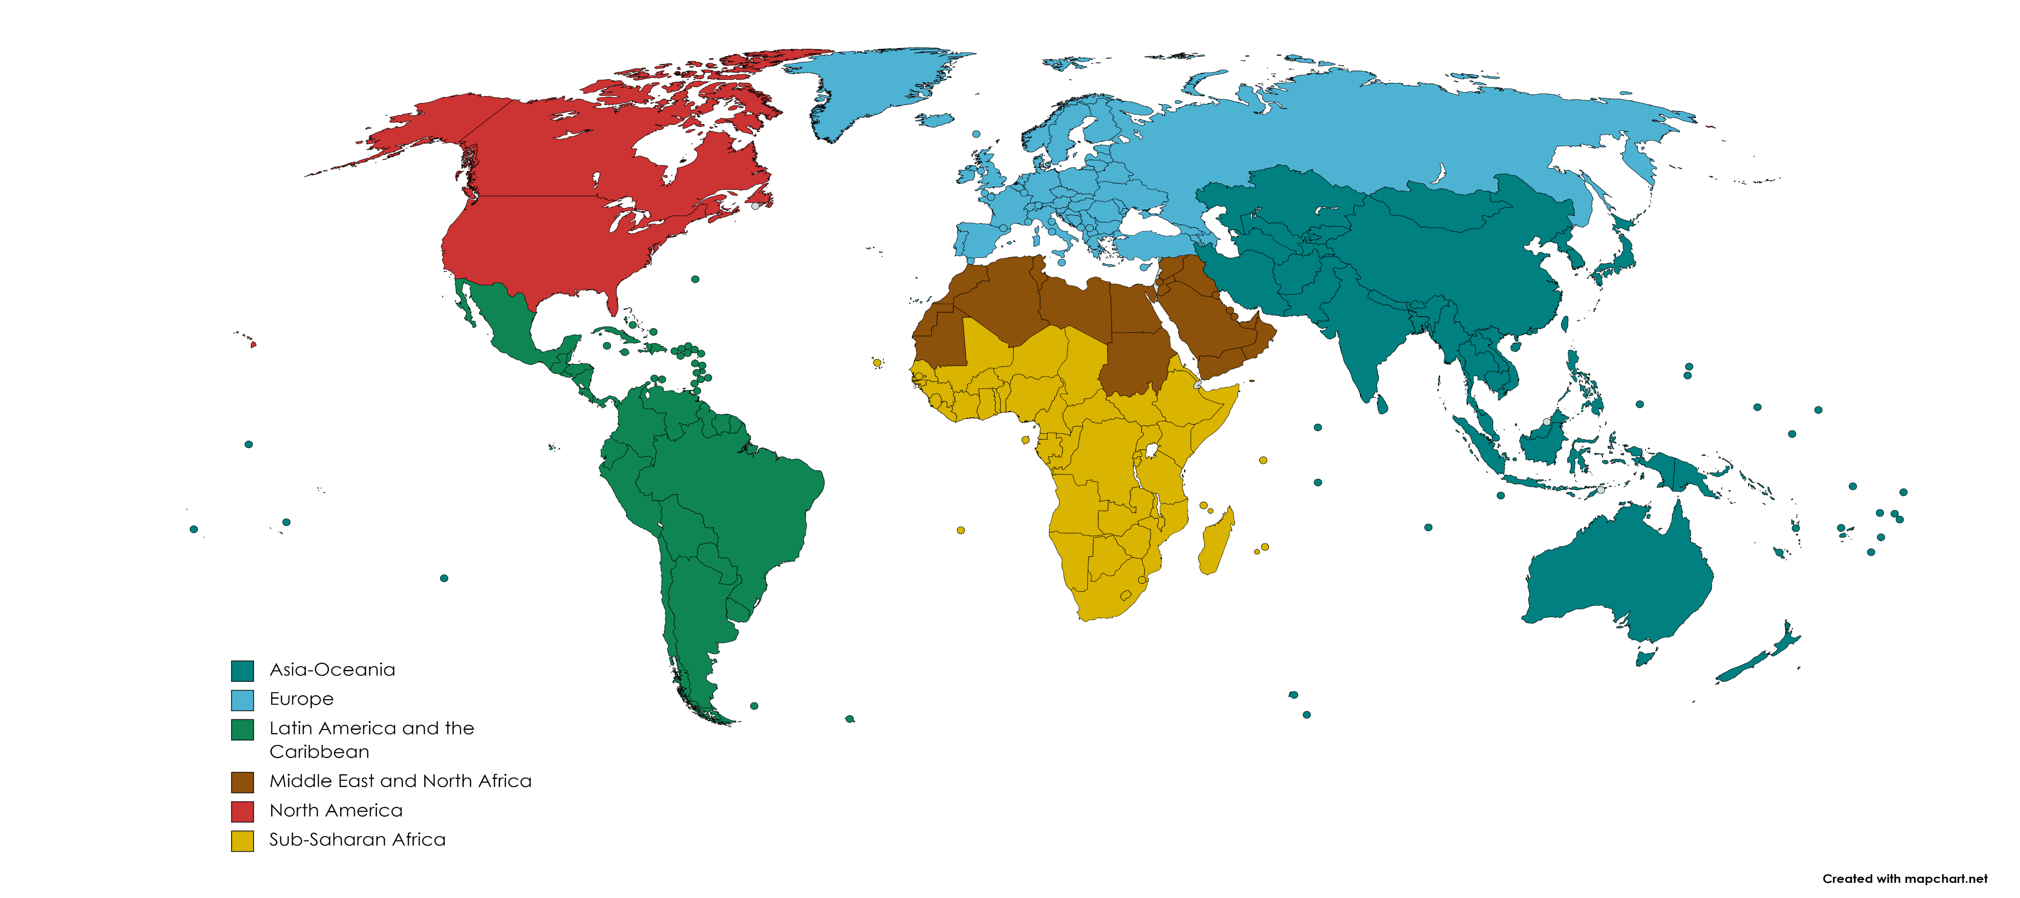

Slide 14
Regional Division Committees: Role
develop and deliver action plans responding to the needs of the library field in their region;
review progress on delivering the IFLA Strategy;
build capacity to advocate at all levels, and identify and work on advocacy priorities, cooperating with Sections and Advisory Committees, as well as other organisations;
contribute actively to efforts to engage Members in the region, building awareness of IFLA’s work, and reach out to non-Members.

Slide 15
Regional Division Committee Members:
Expected experience and skills
interest and experience in library policies and advocacy;
expertise, experience and interest in libraries across in the region;
ability to represent the interests of a diverse range of colleagues;
experience in communication, representation and networking;
willingness and ability to devote time and energy to the role;
an ability to act with respect, trust, confidentiality and transparency

Slide 16
Regional Division Committees
Position | Who can Stand? | Who can Nominate? | How many nominations? | Who can vote?
Regional Division Committee Members (up to 20 per Region) | Anyone | Members and Affiliates within the relevant region | 3 | Members and Affiliates within the relevant region
Note: in order to promote diversity, country caps will apply, limiting the number of Regional Division Committee members who can come from any one country. These are set at the following: Asia-Oceania (2), Europe (1), Latin America and the Caribbean (2), Middle East and North Africa (1), North America (10), Sub-Saharan Africa (2)
Note: if a Regional Division Committee does not come up to 15 members, additional people may be coopted in order to boost diversity. There is also the possibility to name three mentors.

Slide 17
Questions and Answers:
Regional Division Committees

Slide 18
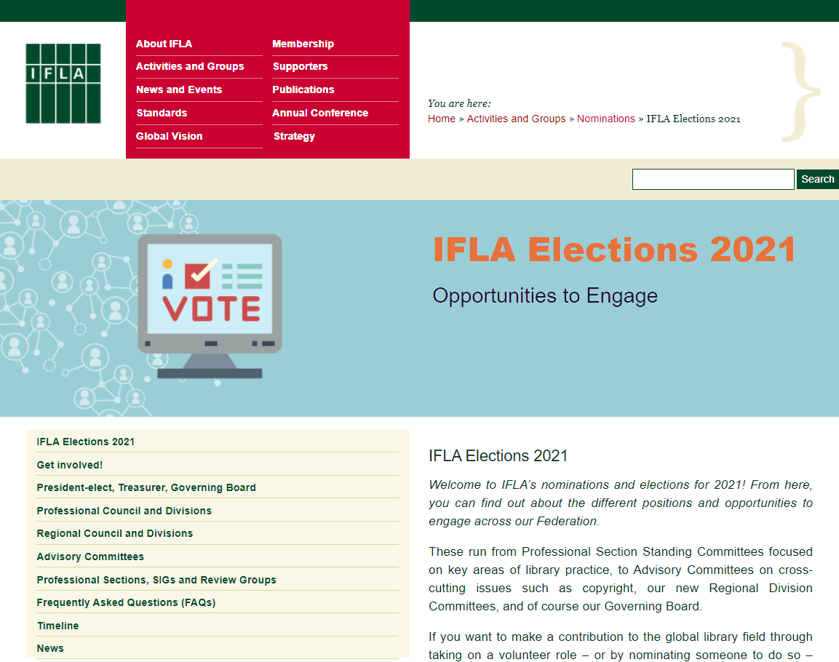
https://www.ifla.org/elections-2021

Slide 19
Nominations Process: Key Considerations
We want this to be the strongest, most diverse range of candidates ever!
Each role requires both a nominee and a nominator*
Nominators should fill in a nominator form (you should have received the link)
Nominees should fill in a nominee consent form (once you know you have enough nominators)
You can make as many nominations as there are places available
Deadline: 13 April, 12pm CEST
* The only exception is Special Interest Group Committee Members, where candidates can stand without a formal nominator

Slide 20
Summary: Association Members can nominate for
President-elect, Treasurer, Governing Board Members, Regional Council Chair
Professional Section Standing Committee members (for Sections for which you are registered)
Regional Division Committee members in your region
Advisory Committee Chairs and members*
Review Group members
* Only National and International Association Members

Slide 21
Institution Members can nominate for
President-elect, Treasurer, Governing Board Members, Regional Council Chair
Professional Section Standing Committee members (for Sections for which you are registered)
Regional Division Committee members in your region
Advisory Committee members
Review Group members

Slide 22
Affiliates (Association, Institution and Personal) can nominate for:
President-elect, Treasurer, Governing Board Members, Regional Council Chair
Professional Section Standing Committee members (for Sections for which you are registered)
Regional Division Committee members in your region

Slide 23
Professional Section Standing Committee Chairs and Secretaries can nominate for:
Professional Council Chair
Professional Section Standing Committee members can nominate for:
Professional Division Committee Chairs

Slide 24
See our elections webpages for more
https://www.ifla.org/elections-2021

Slide 25
Questions and Answers:
Nominations Process

Slide 26
Questions and Answers:
General Questions

Slide 27

24 May, 12pm CEST: Closing of Elections for President-elect, Treasurer, Governing Board members-at-large, Regional Council Chair, Regional Division Committee members, Section Standing Committee members
31 May, 12pm CEST: Closing of Elections for Professional Council Chair and Professional Division Committee Chairs
26 April: Announcement of Candidates and Opening of Electronic Voting for President-elect, Treasurer, Governing Board members-at-large, Regional Council Chair, Regional Division Committee members, Section Standing Committee members
13 April, 12pm CEST: Nominations Close:
3 May: Announcement of Candidates and Opening of Electronic Voting for Professional Council Chair and Professional Division Committee Chairs
14 June: Publication of Results for Professional Council Chair and Professional Division Committee Chairs
1 June: Publication of Results for President-elect, Treasurer, Governing Board members-at-large, Regional Council Chair, Regional Division Committee members, Professional Section Standing Committee members
June – August: Nominations and publication of candidacies for elections held within Committees
Day following the IFLA General Assembly in August 2021: New Committees take office
Next Steps
#WeAreIFLA

Slide 28


We Are
IFLA
#WeAreIFLA

